Slide 1



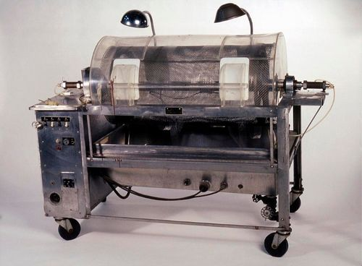
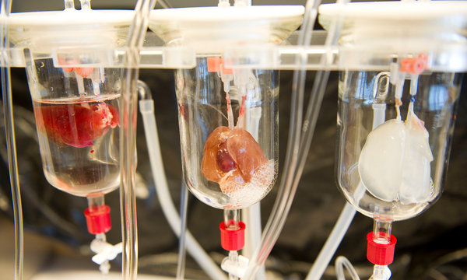
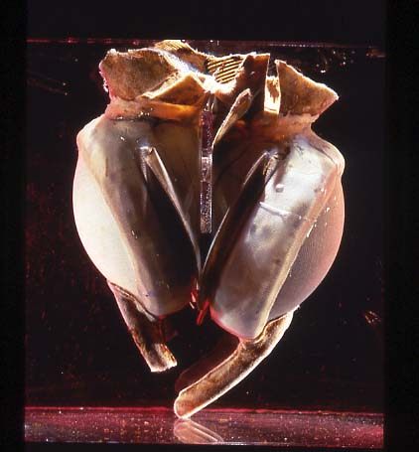

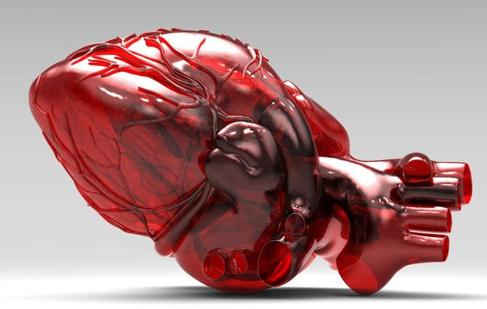


Historical Analysis of Canadian Newspaper Coverage of Organ Transplant and Organ Donation
Jennifer Cheung¹, Gregor Wolbring²
¹Bachelor of Health Sciences, Faculty of Medicine, University of Calgary, Calgary, AB, Canada; email: cheungjf@ucalgary.ca
²Associate Professor, Faculty of Medicine, Department of Community Health Sciences, University of Calgary, Calgary, AB, Canada; email: gwolbrin@ucalgary.ca
Media Coverage Timeline
N = 6983 articles=100%
N = 2404 articles=100%
Artificial kidney from the founder of artificial organs Willem Kolff 1949 [1] and [2]. First kidney transplant, 1954 [2]
First implanted
Artificial heart ,
1969 [3]
N = 603 articles=100%
N = 2125 articles=100%
Organs (%)
Lung | 34.94
Heart | 32.35
Kidney | 28.44
Pancreas | 7.83
Skin | 6.63
Bone | 5.22
Technologies (%)
Artificial | 1.60
Stem cell | 1.10
Mechanical heart | 0.32
Artificial heart | 0.28
Xeno | 0.14
Bionic | 0.06
Tissue engineering | 0.02
Clon | 0.02
3-D print | 0
Artificial ear | 0
Prosthetic | 0
Social groups (%)
Family | 47.01
Patient | 39.78
Government | 18.43
Business | 18.31
Parent | 15.25
Doctor | 12.32
Child | 11.96
Women | 9.08
Nurse | 9.06
Physician | 7.10
Professional | 7.06
Senior | 6.85
Social Issues (%)
Waiting list | 15.39
healthcare | 10.75
cost | 9.87
access | 4.51
Quality of life | 3.20
Ethics | 3.13
afford | 1.80
Organs (%)
Lung | 37.26
Heart | 30.14
Kidney | 20.90
Liver | 8.78
Pancreas | 6.54
Skin | 5.53
Bone | 5.28
Technologies (%)
Clon | 2.79
Artificial | 1.46
Stem cell | 0.96
Mechanical heart | 0.46
Artificial heart | 0.33
3-D print | 0
Artificial ear | 0
Bionic | 0
Prosthetic | 0
Tissue engineering | 0
Xeno | 0
Social groups (%)
Family | 52.10
Patient | 35.72
Business | 16.69
Government | 15.20
Parent | 13.99
Doctor | 13.11
Child | 11.53
Nurse | 8.79
Women | 8.70
Professional | 8.58
Physician | 8.12
Senior | 6.53
Youth | 6.08
Social Issue (%)
Waiting list | 14.82
Healthcare | 10.37
Cost | 9.20
Access | 5.74
Quality of life | 5.24
Ethics | 1.91
Afford | 1.12
N =3 articles
Organs (%)
Heart | 50.75
Kidney | 39.45
Lung | 26.53
Pancreas | 14.43
Liver | 8.00
Stomach | 7.79
Skin | 6.63
Technologies (%)
Artificial | 7.13
Artificial heart | 1.82
Mechanical heart | 0.33
3-D print | 0
Artificial ear | 0
Bionic | 0
Clon | 0
Prosthetic | 0
Tissue engineering | 0
Stem cell | 0
Social groups (%)
Patient | 53.06
Family | 33.40
Parent | 23.55
Child | 20.23
Business | 19.90
Doctor | 19.07
Government | 16.25
Physician | 13.43
Infant | 13.10
Nurse | 10.94
Women | 9.45
Babies | 7.79
Professional | 6.97
Social Issues (%)
Cost | 12.27
Ethics | 9.05
Waiting list | 6.78
Healthcare | 6.30
Access | 2.98
Afford | 2.81
Quality of life | 1.65
Organs (%)
Heart | 39.74
Lung | 36.21
Kidney | 29.97
Pancreas | 10.19
Bone | 6.58
Skin | 6.01
Technologies (%)
Artificial | 2.82
Artificial heart | 0.47
Xeno | 0.23
Mechanical heart | 0.10
Stem cell | 0.05
Tissue engineering | 0.05
3-D print | 0
artificial ear | 0
Bionic | 0
Clon | 0
Prosthetic | 0
Social groups (%)
Family | 44.95
Patient | 44.01
Business | 25.69
Parent | 18.93
Government | 18.79
Child | 17.47
Doctor | 14.70
Nurse | 10.94
Women | 9.91
Professional | 8.97
Physician | 8.83
Social Issues (%)
Waitinglist | 15.36
Cost | 12.30
Healthcare | 12.16
Ethics | 5.12
Access | 4.84
Quality of life | 3.47
Afford | 2.68
Organs (n=)
Lung | 2
Heart | 1
Liver | 1
Technologies n=0
Social groups n=0
women | 2
child | 1
family | 1
nurse | 1
parent | 1
patient | 1
Social Issues n=0
Introduction
Organs from
Stem cells [9]
Organ transplants are often the
only option for patients facing organ failure
Organ donation is constantly
promoted to alleviate the shortage of organs
and to decrease the wait list
In Canada, in 2012, 1,900 transplants were
performed, 3,404 patients were awaiting
transplants, and 481 patients either withdrew or
died while waiting on the transplant list.[4]
Objective
1970
1980
1990
2000
2010
2014
Media are seen to enable social participation [5], help set the discussion agenda for society, and create the boundaries where debates take place [6-7]. Organ transplantation and organ donation face many issues. We performed an analysis of issue-specific news frames that are communicated to Canadian readers to ascertain the utility of the coverage for the reader and the advancement of organ transplantation and organ donation.
Methods
ArbioCor
Artificial
heart,
2001 [8]
3D printed
heart [10]
Source of historical and contemporary data: the Calgary Herald and the Canadian Newsstand Complete database (n=300 Canadian newspapers) from 1978-2014
Stage 1 (data not provided)
Downloaded all articles with the term “organ” in the title from the Calgary Herald (n=353) accessed through the Canadian Newsstand Complete database provided by the University of Calgary into Atlas-ti, a qualitative data analysis software
Performed a historical qualitative content analysis of the Calgary Herald focusing on organs, technologies, social groups, and social issues mentioned
Stage 2: Identified all newspaper articles in the Canadian Newsstand Complete database for articles containing the terms “organ transplant” or “organ donation” from 1978-2014 (n=12,118) and searched these articles for keywords identified in stage 1 of the project to produce the quantitative data presented here.
Discussion
Technology: Technologies were under investigated. Xeno-transplantation was mentioned from 1990-2009 but not anymore between 2010-2014, organ printing (3D printer) is not a covered issue, words like bionic and tissue engineering have low visibility
Social Groups: The social groups mentioned stayed the same including the ones rarely if at all mentioned (i.e. Indigenous people, immigrants, people with disabilities) (data not shown). The coverage is a problem for socially disadvantaged groups.
Organs: Throughout the years, the top three organs mentioned were heart, lung and kidney
Social issues: The coverage of social issues seems not to have led to a change and is problematic. The top six mentioned social issues were the same since 1980 with other issues such as equity, equality, and discrimination consistently less than 0.5%; coverage of ethics decreased from 9.05% in the 1980s to 1.91% in 2010 onward
References:
http://blog.americanhistory.si.edu/osaycanyousee/2013/11/a-tour-of-the-best-bionic-objects-in-the-collection.html
http://www.kidney.ca/page.aspx?pid=1521
3.. http://americanhistory.si.edu/collections/search/object/nmah_688682
4. Canadian Institute for Health Information (CIHI) e-Statistics on Organ Transplants, Waiting Lists and Donors. Available online: http://www.cihi.ca/CIHI-ext-
portal/pdf/internet/REPORT_STATS2012_PDF_EN (30th January, 2013),
5. Nord, D. P., A Republican Literature: A Study of Magazine Reading and Readers in Late Eighteenth-Century New York. American Quarterly 1988, 40 (1), 42-64.
Wallack, L., Mass media and health promotion: Promise, problem, and challenge. In Mass communication and public health: Complexities and conflicts, Atkins, C.;
Wallack, L., Eds. Sage: Newbury Park, CA, 1990.
Wallack, L. M., Mass media and health promotion: The promise, the problem, the challenge. School of Public Health, University of California: 1989.
8. http://americanhistory.si.edu/collections/search/object/nmah_1211787
9. http://www.nytimes.com/2012/09/16/health/research/scientists-make-progress-in-tailor-made-organs.html?pagewanted=all&_r=0
10. http://www.timeslive.co.za/thetimes/2013/09/02/3d-printing-of-human-organs
Conclusion
The nature of the coverage in general changed very little over the years. Canadian newspapers cover the topic in a rather limited fashion with little utility for the general public to understand emerging trends, existing social issues, and possible solutions.

